Slide 1
THE RELIABLE AND ROBUST DDOS ATTACK DETECTION IN IOT USING NEURAL NETWORKS

Slide 2
BATCH-C11 Guide:Mrs.R.Devi
S.VARSHA
2017PECCS248
R.VALARMATHI
2017PECCS246

Slide 3
ABSTRACT Application Layer Distributed Denial of Service (DDoS) attacks are very challenging to detect and mitigate. The various possible application layer attacks are HTTP flooding, XML attack, DNS attacks, etc. The most common and renowned application layer attack is HTTP flooding.There are various research solutions proposed by validating against HTTP flooding; using tools such as Golden Eye, LOIC, proprietary tools, etc. HTTP flooding attacks generated using any existing tools may not exhibit similar characteristics of the real time HTTP flooding attack. Various methods were used to defend these attacks based on distributed schemes with certain difficulties to count the packets or duplicates sent by a node. This is due to lack of communication infrastructure. Two limits are used to mitigate packet flood and replica flood attacks, respectively. Violation of both the limits can be easily noticed by claim-carry-and check. The inconsistency check against full claims is trivial. This is designed to work in a distributed system. Moreover, it allows tolerating a little amount of attackers for collision. A new attack, the Ad Hoc Flooding Attack, results in denial of service when used against all ondemand ad hoc networks routing protocols. In this attack, the attacker either broadcasts a lot of Route Request packets for node ID who is not in networks, or sends a lot of DATA packets to consume the bandwidth so as to congest in links.

Slide 4
LITERATURE SURVEY :
Title | SDN-Assisted Slow HTTP DDoS Attack Defense Method
Authors | Kiwon Hong, Younjun Kim, Hyungoo Choi, and Jinwoo Park
Published Year | 2017
Efficiency | Defeat application-level DDoS attacks Use cross-layer traffic analysis Bound to a variety of transport protocols
Drawbacks | Various DDoS has not been well addressed in this paper Computational cost in training the model is high Very calculation intensive while training the model
Description | A Slow HTTP Distributed Denial of Service (DDoS) attack causes a web server to be unavailable, but it is difficult to detect in a network because its traffic patterns are similar to those of legitimate clients. In this paper, we propose a network-based Slow HTTP DDoS attack defense method which is assisted by a Software-Defined Network (SDN) that can detect and mitigate Slow HTTP DDoS attacks in the network. Simulation results show that the proposed Slow HTTP DDoS attack defense method successfully protects web servers against Slow HTTP DDoS attacks.

Slide 5
LITERATURE SURVEY :
Title | Software-Defined Networking (SDN) and Distributed Denial of Service (DDoS) Attacks in Cloud Computing Environments: A Survey, Some Research Issues, and Challenges
Authors | Qiao Yan, F. Richard Yu Qingxiang Gong, and Jianqiang Li
Published Year | 2015
Efficiency | It is cost effective, by allowing reuse of information extracted during detection. It makes no compromise of QoS Reduces the consumption of hardware resources
Drawbacks | Several important issues and research challenges which are open and yet to be addressed It is not appropriate when the dataset available is large Lead to the generation of bad candidate proposals
Description | In this paper, we discuss the new trends and characteristics of DDoS attacks in cloud computing, and provide a comprehensive survey of defense mechanisms against DDoS attacks using SDN. In addition, we review the studies about launching DDoS attacks on SDN, as well as the methods against DDoS attacks in SDN. To the best of our knowledge, the contradictory relationship between SDN and DDoS attacks has not been well addressed in previous works. This work can help to understand how to make full use of SDN’s advantages to defeat DDoS attacks in cloud computing environments and how to prevent SDN itself from becoming a victim of DDoS attacks, which are important for the smooth evolution of SDN-based cloud without the distraction of DDoS attacks.

Slide 6
LITERATURE SURVEY :
Title | Botnet in DDoS Attacks: Trends and Challenges
Authors | Nazrul Hoque, Dhruba K Bhattacharyya and Jugal K Kalita
Published Year | 2015
Efficiency | Integrates multiple traceback mechanism with customization support Effectively block Slow HTTP DDoS attacks, allowing a web server to sustain its normal operation Supports distributed architecture
Drawbacks | Does not provide a generic solution Still elusive to find a prevention mechanism that can protect network resources from unknown attacks Leads to a biased outcome of predictions in terms of misclassification error and accuracy rates.
Description | Botnets pose a major threat to network security as they are widely used for many Internet crimes such as DDoS attacks, identity theft, email spamming and click fraud. Botnet based DDoS attacks are catastrophic to the victim network as they can exhaust both network bandwidth and resources of the victim machine. This paper presents a comprehensive overview of DDoS attacks, their causes, types with a taxonomy and technical details of various attack launching tools. A detailed discussion of several botnet architectures, tools developed using botnet architectures and pros and cons analysis are also included. Furthermore, a list of important issues and research challenges is also reported in the paper.

Slide 7
LITERATURE SURVEY :
Title | DDoS Tools: Classification, Analysis and Comparison
Authors | Bharti Nagpal, Pratima Sharma, Naresh Chauhan, Angel Panesar
Published Year | 2015
Efficiency | Detecting either low-rate or high-rate DDoS attacks can leverage network-wide knowledge of its own network to detect DDoS attacks through techniques such as trafficpattern analysis, or machine learning Achieved competitive performance on various datasets
Drawbacks | Performance is also highly influenced by multiple user parameters. Lack of unbiased evaluation frameworks, including benchmark datasets Rely on the observation of abnormal traffic patterns found in network
Description | In the last few years, it is recognised that DDoS attack tools and techniques are emerging as effective, refined, and complex to indicate the actual attackers. Due to the seriousness of the problem many detection and prevention methods have been recommended to deal with these types of attacks. This paper aims to provide a better understanding of the existing tools, methods and attack mechanism. In this paper, we commenced a detailed study of various DDoS tools. This paper can be useful for researchers and readers to provide the better understanding of DDoS tools in present times.

Slide 8
TECHNOLOGY STACK Hardware requirement Hardware Minimum Requirement Disk Space 32 GB or more,10 GB or more for Foundation Edition Processor 1.4 GHz 64 bit Memory 512 MB Display (800 × 600) Capable video adapter and monitor

Slide 9
TECHNOLOGY STACK Software requirement Backend Technologies ✓ Python -Anaconda ✓ Numpy ✓ Sci-learn ✓ Jupyter Notebook Frontend Technologies ✓ Web Technologies ✓ Bootstrap

Slide 10
EXISTING SYSTEM: ✓ The existing system Misbehavior detection system (MDS) can be deployed to detect and prevent internal attacks.In this project,We propose a machine learning and reputation based MDS to enhance the detection accuracy. ✓ Existing system MDS is trained using datasets generated through extensive simulation based on the realistic vehicular network environment. To improve the accuracy of the detection, we have employed the DempsterShafer (DS) theory-based collaborative misbehavior detection system. ✓ In the existing system scheme, the reputation score of each vehicle is used as a belief value for Dempster-Shafer based feedback combination. In addition, existing system is a beta distribution based reputation update and revocation scheme. An attacker can control some vehicles or groups of vehicles to broadcast false information. An attacker can broadcast false alerts such as emergency vehicle approaching or icy road conditions to disrupt the normal operation of the traffic. These kinds of false alerts can cause huge accidents, thus, it is very crucial to detect them.

Slide 11
DRAWBACKS OF EXISTING SYSTEM: ✓ It achieves low-latency in delivery with less energy consumption. ✓ The detection performance is not improved. ✓ Parties need to be involved. ✓ Cannot overcome inter-packet dependency.

Slide 12
PROPOSED SYSTEM: ✓ The proposed system presents a period-based defense mechanism .PDM scheme is based on the periods and uses a blacklist to efficiently prevent the data flooding attack, by checking the data packet floods at the end of each period in order to enhance the throughput of burst traffic. Therefore, it can guarantee the Quality of Service (QoS) of burst traffic. As a result of which many data packets are forwarded at a high rate for the whole duration. Flood attacks are launched by malicious or selfish nodes. ✓ In the proposed Single-copy routing after sending a packet out, a node deletes its own copy of the packet. Thus, each packet only has one copy in the network. ✓ In the proposed Multicopy routing to the source node of a packet sprays a certain number of replicas of the packet to other nodes and each copy is separately routed using the single-copy strategy. The maximum number of copies that each packet can have is set. ✓ In the proposed, Propagation routing when a node locates it appropriate (according to the routing algorithm) to send a packet to another encountered node, it replicates that packet to the encountered node and keeps its own fake. There is no preset limit over the number of copies a packet can have. In Propagation, a node duplicates a packet to another encountered node if the latter has more regular contacts with the destination of the packet.

Slide 13
ADVANTAGES OF PROPOSED SYSTEM: ✓ Reduce false alarm probability ✓ Cost reduction for its users ✓ Higher accuracy ✓ Opaqueness since routers need not be involved. ✓ Successfully minimize the amount of traffic

Slide 14
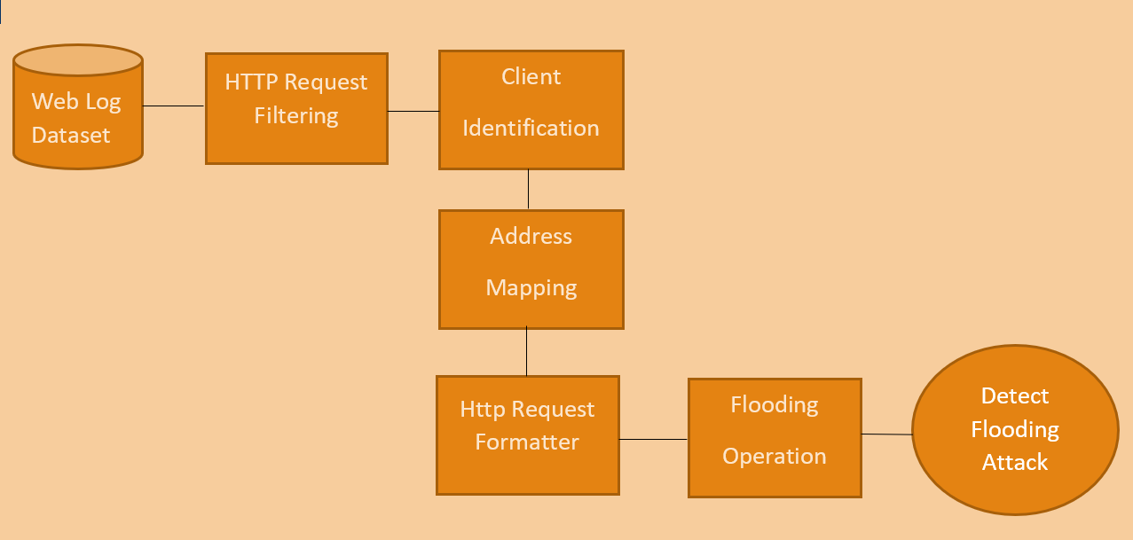
SYSTEM ARCHITECTURE:

Slide 15
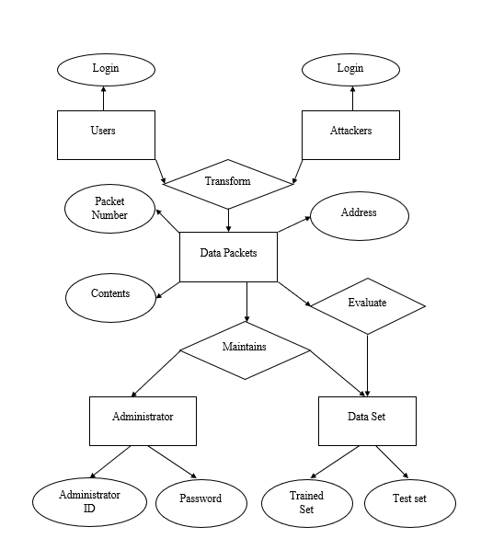
System Design:(ER diagram)

Slide 16
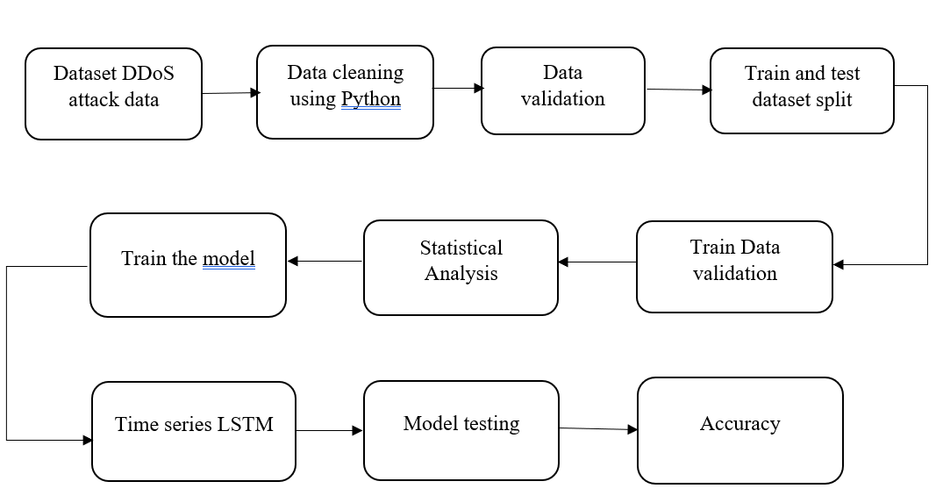
System Design:(Data Flow diagram)

Slide 17
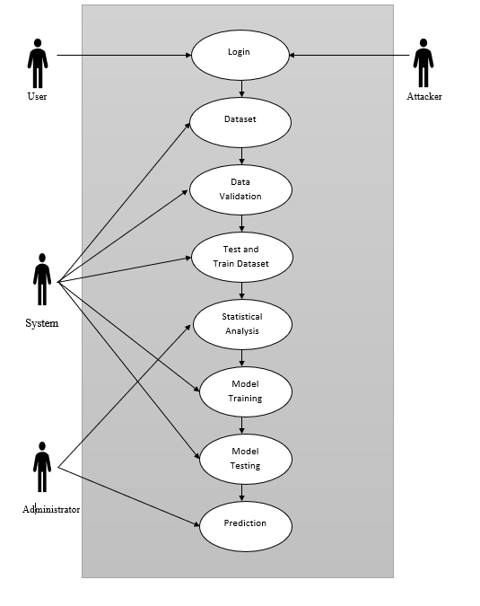
System Design:(Usecase diagram)

Slide 18
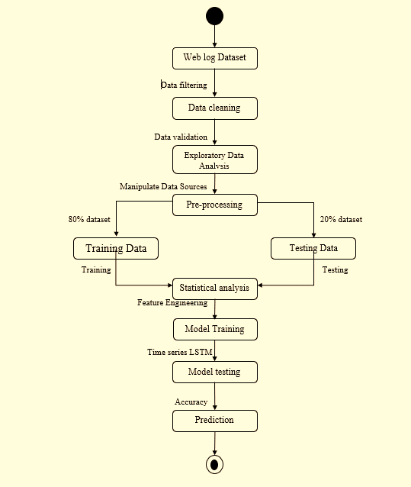
System Design:(Activity diagram)

Slide 19
MODULES: Module 1 : Exploratory Data Analysis Module 2 : Pre-processing Module 3 : Feature Engineering Module 4 : Prediction

Slide 20
Module 1 : Exploratory Data Analysis ✓ Exploratory Data Analysis (EDA) is the first step in your data analysis process. Here, you make sense of the data you have and then figure out what questions you want to ask and how to frame them, as well as how best to manipulate your available data sources to get the answers you need. ✓ Exploratory Data Analysis is valuable to data science projects since it allows to get closer to the certainty that the future results will be valid, correctly interpreted, and applicable to the desired business contexts. Such level of certainty can be achieved only after raw data is validated and checked for anomalies, ensuring that the data set was collected without errors. ✓ EDA also helps to find insights that were not evident or worth investigating to business stakeholders and data scientists but can be very informative about a particular business. ✓ EDA is performed in order to define and refine the selection of feature variables that will be used for machine learning. Once data scientists become familiar with the data set, they often have to return to feature engineering step, since the initial features may turn out not to be serving their intended purpose. Once the EDA stage is complete, data scientists get a firm feature set they need for supervised and unsupervised machine learning.

Slide 21
Module 2 : Pre-processing ✓ Sometimes you may find some data are missing in the dataset. We need to be equipped to handle the problem when we come across them. Obviously you could remove the entire line of data but what if you are unknowingly removing crucial information? Of course we would not want to do that. One of the most common idea to handle the problem is to take a mean of all the values of the same column and have it to replace the missing data. ✓ The library that we are going to use for the task is called Scikit Learn preprocessing. It contains a class called Imputer which will help us take care of the missing data. Sometimes our data is in qualitative form, that is we have texts as our data. We can find categories in text form. Now it gets complicated for machines to understand texts and process them, rather than numbers. Therefore, we have to encode the categorical data. ✓ Now we need to split our dataset into two sets — a Training set and a Test set. We will train our machine learning models on our training set and then we will test the models on our test set to check how accurately it can predict. A general rule of the thumb is to allocate 80% of the dataset to training set and the remaining 20% to test set. For this task, we will import test_train_split from model_selection library of scikit.

Slide 22
Module 3 : Feature Engineering Filter methods are generally used as a preprocessing step. The selection of features is independent of any machine learning algorithms. Instead, features are selected on the basis of their scores in various statistical tests for their correlation with the outcome variable. The correlation is a subjective term here. For basic guidance, you can refer to the following table for defining correlation co-efficients. Pearson’s Correlation: It is used as a measure for quantifying linear dependence between two continuous variables X and Y. Its value varies from -1 to +1. LDA: Linear discriminant analysis is used to find a linear combination of features that characterizes or separates two or more classes (or levels) of a categorical variable. ANOVA: ANOVA stands for Analysis of variance. It is similar to LDA except for the fact that it is operated using one or more categorical independent features and one continuous dependent feature. It provides a statistical test of whether the means of several groups are equal or not. Chi-Square: It is a is a statistical test applied to the groups of categorical features to evaluate the likelihood of correlation or association between them using their frequency distribution

Slide 23
Module 4 : Prediction ✓ Once training is complete, it’s time to see if the model is any good, using Evaluation. This is where that dataset that we set aside earlier comes into play. ✓ Evaluation allows us to test our model against data that has never been used for training. This metric allows us to see how the model might perform against data that it has not yet seen. This is meant to be representative of how the model might perform in the real world. ✓ A good rule of thumb I use for a training-evaluation split somewhere on the order of 80/20 or 70/30. Much of this depends on the size of the original source dataset. If you have a lot of data, perhaps you don’t need as big of a fraction for the evaluation dataset. ✓ Once you’ve done evaluation, it’s possible that you want to see if you can further improve your training in any way. We can do this by tuning our parameters. There were a few parameters we implicitly assumed when we did our training, and now is a good time to go back and test those assumptions and try other values.

Slide 24
Performance Analysis: ✓ The technique of comparing the performance of a specific situation in contrast to the aim and yet executed. The first step of analyzing raw data is validated and checked for anomalies , ensuring that the data set was collected without errors and then pre-processing step splits the dataset into trained set and test set , after training the model ,it’s completely ready for evaluation . Once evaluation done , ✓ It’s possible you can further improve the training any way and the prediction of attackers and non-attackers counts will be well aimed than the existing model. There were a few parameters we implicitly assumed when we did our training and now is the good time to go back and test those assumptions and try other values.

Slide 25
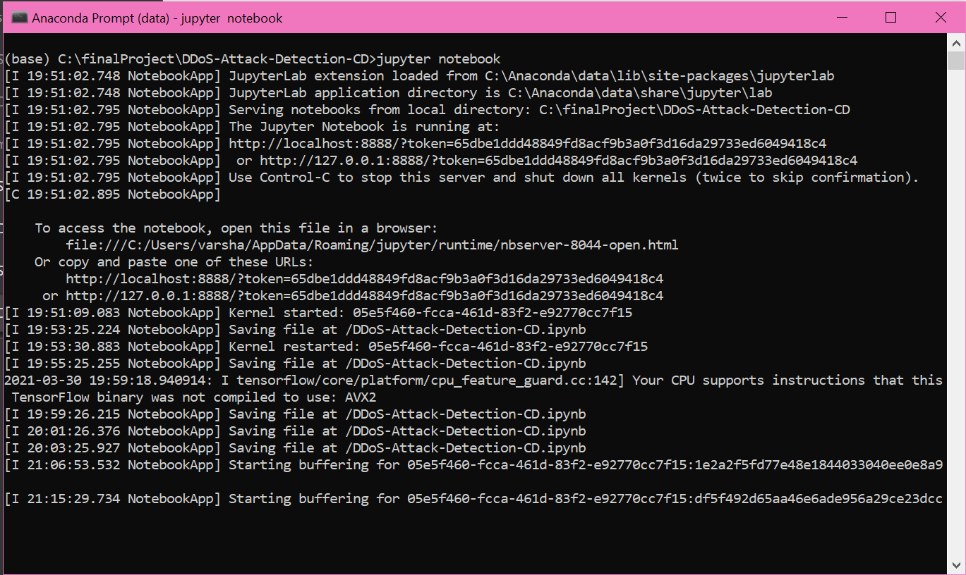
Screenshots(anaconda prompt)

Slide 26
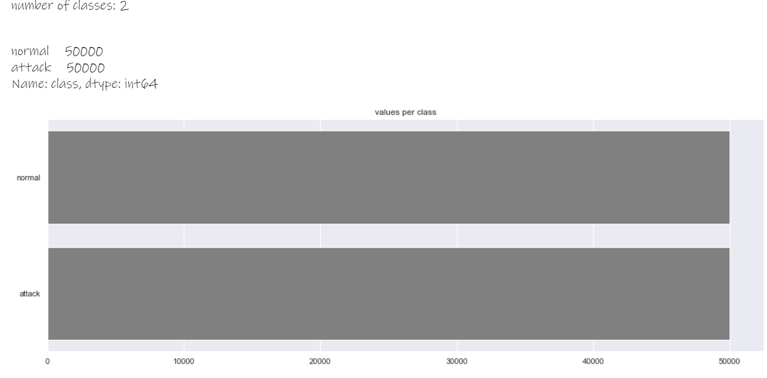
Screenshots(Value per class)

Slide 27
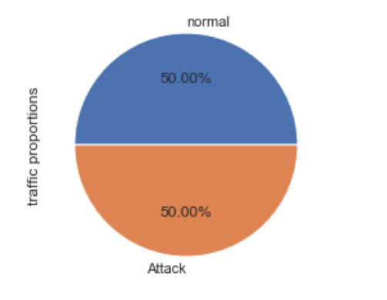
Screenshots(Pie chart for normal and attack)

Slide 28
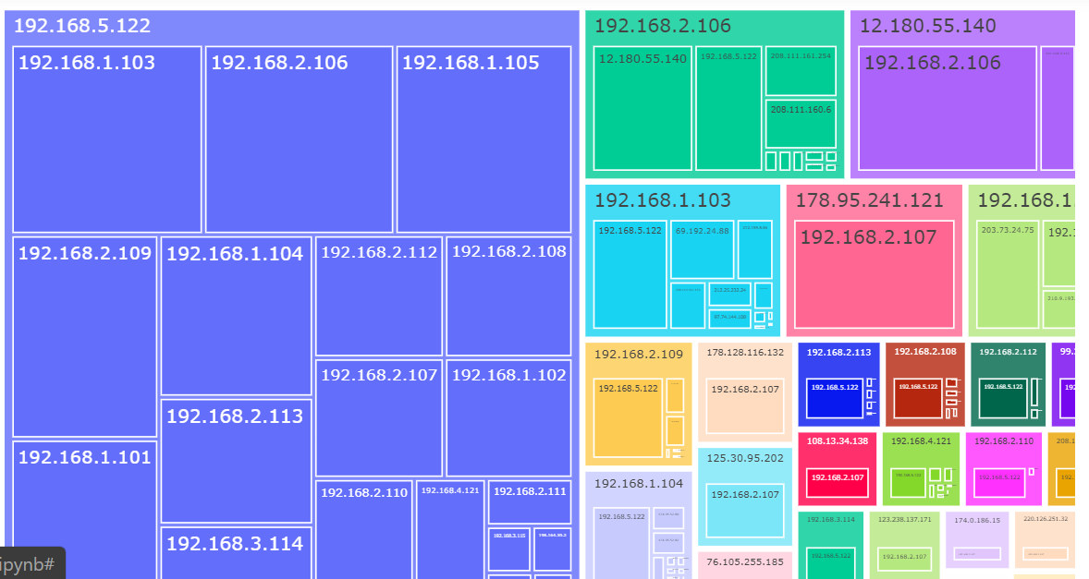
Screenshots

Slide 29
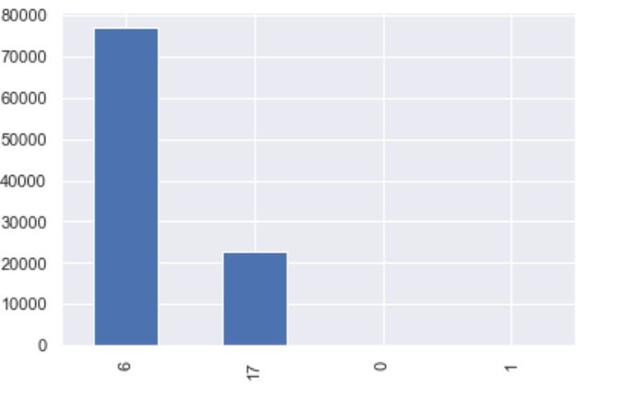
Screenshots(IP Protocol)

Slide 30
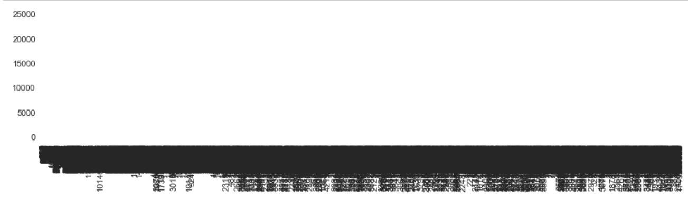
Screenshots(TCP Acknowledgment)

Slide 31
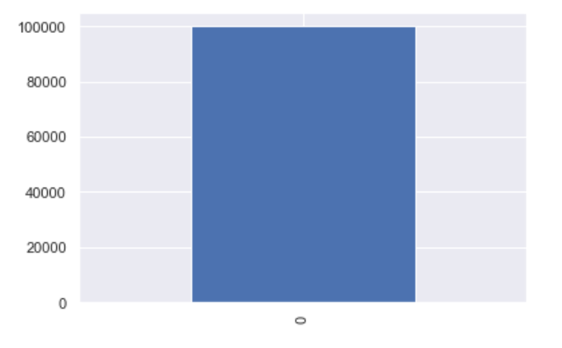
Screenshots(Reverse bit)

Slide 32
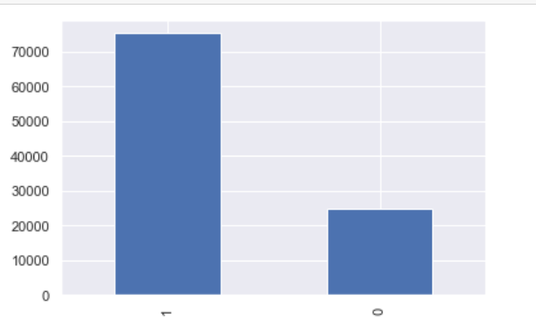
Screenshots(Don’t fragment)

Slide 33
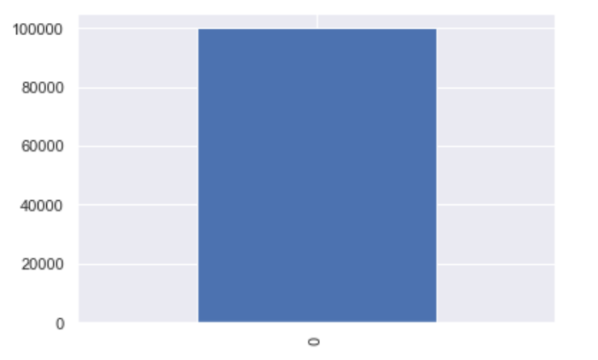
Screenshots(More fragment)

Slide 34
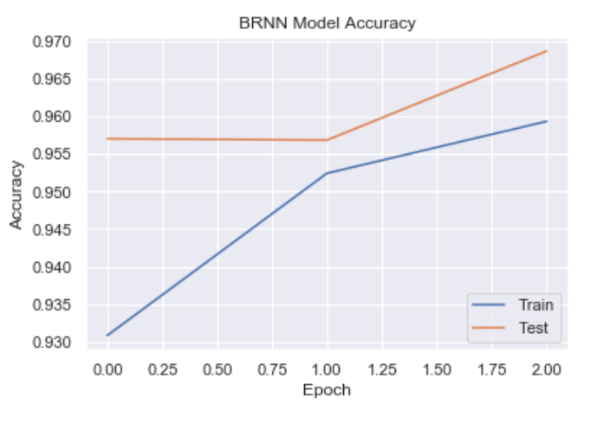
Screenshots(BRNN Model accuracy)

Slide 35
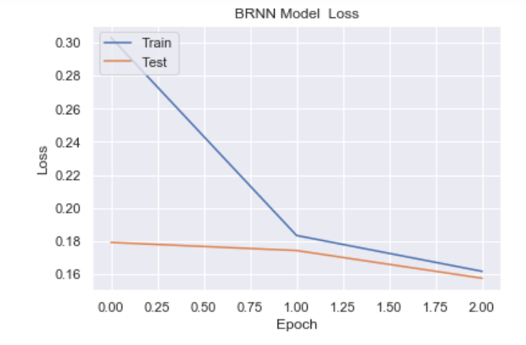
Screenshots(BRNN Model loss)

Slide 36
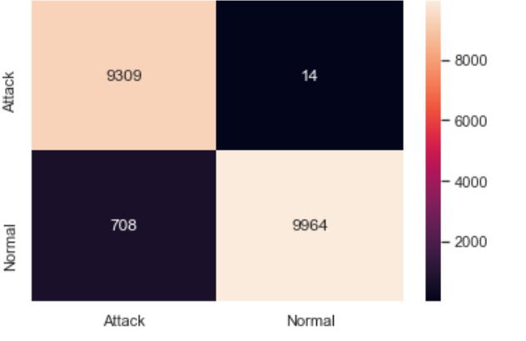
Screenshots(output)

Slide 37
CONCLUSION Reduce the attacks by employing rate limitations and probablistically detect the number of packets and the Long-short term memory algorithm is used to detect the approximate counting of packets which are violating the rate limits . This works are implemented in distributed manner.They easily reduce the throughput of burst traffic by comparing with the simple threshold .This is achieved by using proposed scheme and more over it is better than old scheme. FUTURE ENHANCEMENTS In future, the model can be implemented on other attacks like Application Layer Attack, Protocol Attack, Volumetric Attack with large dataset using ANN.

Slide 38
REFERENCES [1]Compagno, & al., “Poseidon: Mitigating interest flooding ddos attacks in named data networking,” in Local Computer Networks (LCN), Intl’ Conf. on. IEEE, 2013, pp. 630– 638. [2]Afanasyev, & al., “Interest flooding attack and countermeasures in named data networking,” in IFIP Networking Conference. IEEE, 2013, pp. 1–9. [3]Ghali, & al., “Closing the floodgate with stateless content-centric networking,” in 2017 26th International Conference on Computer Communication and Networks (ICCCN), July 2017, pp. 1–10. [4]T. Zhi, H. Luo, and Y. Liu, “A gini impurity-based interest flooding attack defence mechanism in ndn,” IEEE Communications Letters, vol. 22, no. 3, pp. 538–541, March 2018.

Slide 39
REFERENCES [5]Y. Xin, & al., “Detection of collusive interest flooding attacks in named data networking using wavelet analysis,” in IEEE Military Communications Conference (MILCOM), Oct 2017, pp. 557–562. [6]K. Wang, & al., “On the urgency of implementing Interest NACK into CCN: from the perspective of countering advanced interest flooding attacks” in IET Networks, vol. 7, no. 3, pp. 136–140, 2018. [7]S. DiBenedetto and C. Papadopoulos, “Mitigating poisoned content with forwarding strategy,” in 2016 IEEE Conference on Computer Communications Workshops (INFOCOM WKSHPS), April 2016, pp. 164–16

Slide 40
REFERENCES [8]Yi, & al., “A case for stateful forwarding plane,” Computer Communications, vol. 36, no. 7, pp. 779–791, 2013. [9]Amandeep Verma Manpreet Singh Gujral “A Comprehensive Appraisal of Ad hoc Networks” International Journal of Computer Applications (0975– 8887) Volume 49– No.22, July 2012. [10]Shahanaz Begum I, Geetharamani G, “DDoS Attack detection and Prevention in Private Cloud Environment “,International Journal of Innovations in Engineering and Technology (IJIET), Vol.7 Issue.3, Oct 2016, pp. 527- 531 [11]S. Umarani, D. Sharmila, ‘‘Predicting Application Layer DDoS Attacks Using Machine Learning Algorithms”, International Journal of Computer, Electrical, Automation, Control and Information Engineering Vol.8, No.10, 2014, pp. 1912-1917

Slide 41
THANK YOU

